Slide 1
Learning & Development Enabling development, Impacting growth…
Apache Spark

Slide 2
What is Spark streaming?
What is Spark streaming?
Spark streaming : How it works ?
Spark DStreams
A Twitter example
Fault-tolerance
Stateful Stream Processing
Q & A

Slide 3
What is Spark Streaming?
Framework for large scale stream processing
Scales to 100s of nodes
Can achieve second scale latencies
Integrates with Spark’s batch and interactive processing
Provides a simple batch-like API for implementing complex algorithm
Can absorb live data streams from Kafka, Flume, ZeroMQ, etc.
Spark streaming is an extension of the core Spark API that enables scalable, high-throughput stream processing of live data streams.

Slide 4
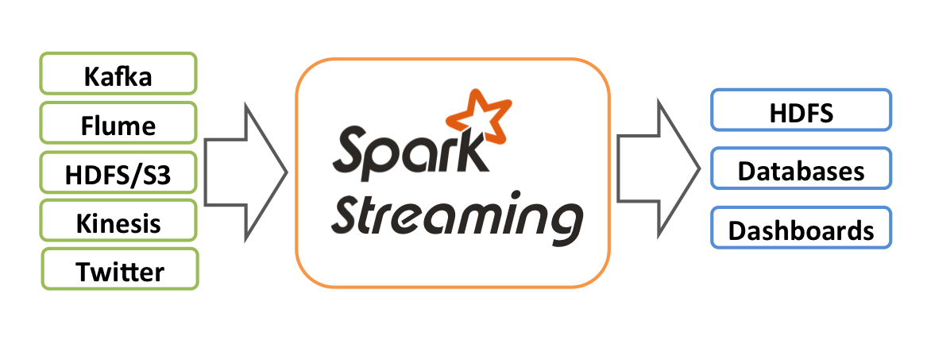
What is Spark Streaming?
Data can be ingested from many sources like Kafka, Flume, Twitter, ZeroMQ, Kinesis, or TCP sockets
Source: Databricks

Slide 5
Spark streaming : How it works ?
What is Spark streaming?
Spark streaming : How it works ?
Spark DStreams
A Twitter example
Fault-tolerance
Stateful Stream Processing
Q & A

Slide 6
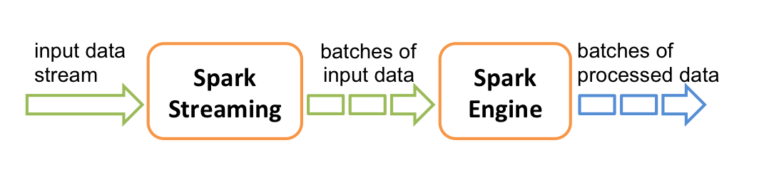
Spark Streaming : How it Works ?
Spark Streaming receives live input data streams and divides the data into batches.
Each batch is processed by the Spark engine to generate the final stream of results.
Source: Databricks

Slide 7
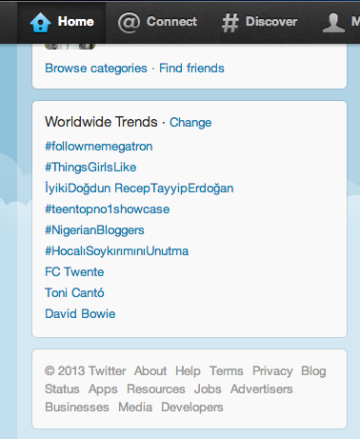
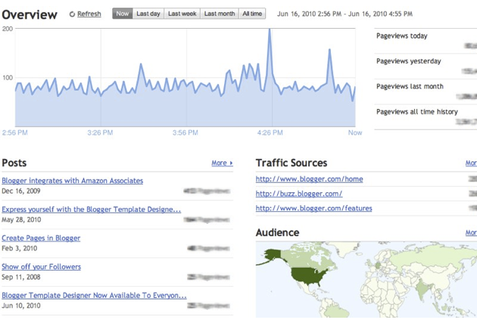
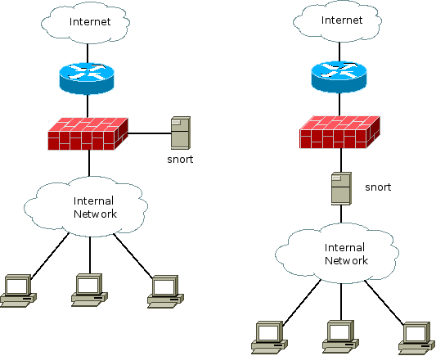
Spark Streaming : How it Works ?
Motivation
Many important applications must process large streams of live data and provide results in near-real-time
Social network trends
Website statistics
Intrustion detection systems
Require large clusters to handle workloads
Require latencies of few seconds
Source: Databricks

Slide 8
Spark DStreams
What is Spark streaming?
Spark streaming : How it works ?
Spark DStreams
A Twitter example
Fault-tolerance
Stateful Stream Processing
Q & A

Slide 9
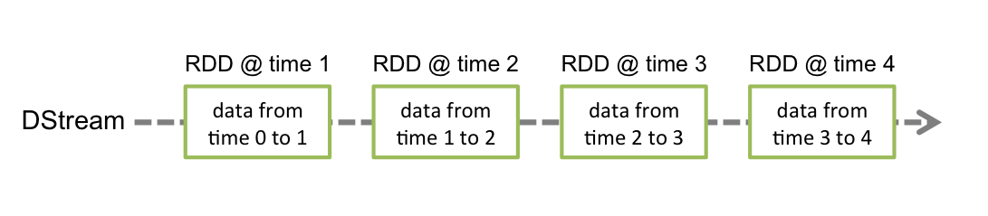
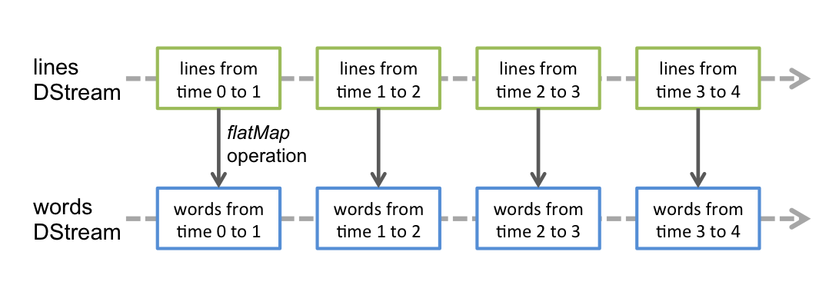
Spark DStream
Run a streaming computation as a series of very small, deterministic batch jobs

Slide 10
Spark DStreams
Run a streaming computation as a series of very small, deterministic batch jobs
Chop up the live stream into batches of X seconds
Spark treats each batch of data as RDDs and processes them using RDD operations
Finally, the processed results of the RDD operations are returned in batches
Live data stream
Spark
Streaming
batches of X seconds
Spark
processed results

Slide 11
Spark DStreams
Run a streaming computation as a series of very small, deterministic batch jobs
Batch sizes as low as ½ second, latency of about 1 second
Potential for combining batch processing and streaming processing in the same system
Live data stream
Spark
Streaming
batches of X seconds
Spark
processed results

Slide 12
Spark DStream
Out of the box Spark provide
Kafka
HDFS
Flume
Akka Actors
Raw TCP sockets
Very easy to write a receiver for your own data source

Slide 13
A Twitter Example
What is Spark streaming?
Spark streaming : How it works ?
Spark DStreams
A Twitter example
Fault-tolerance
Stateful Stream Processing
Q & A

Slide 14

Example – Get hashtags from Twitter
val tweets = ssc.twitterStream()
DStream: a sequence of RDDs representing a stream of data
Twitter Streaming API
batch @ t+1
batch @ t
batch @ t+2
tweets DStream
stored in memory as an RDD (immutable, distributed)
Source:datadricks

Slide 15
Example – Get hashtags from Twitter
val tweets = ssc.twitterStream()
val hashTags = tweets.flatMap (status => getTags(status))
new DStream
transformation: modify data in one DStream to create another DStream
batch @ t
batch @ t+1
batch @ t+2
tweets DStream
flatMap
flatMap
flatMap
hashTags Dstream
[#cat, #dog, … ]
…
new RDDs created for every batch
Source:datadricks

Slide 16
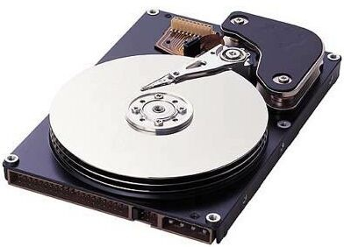
Example – Get hashtags from Twitter
val tweets = ssc.twitterStream()
val hashTags = tweets.flatMap (status => getTags(status))
hashTags.saveAsHadoopFiles("hdfs://...")
output operation: to push data to external storage
batch @ t
batch @ t+1
batch @ t+2
tweets DStream
flatMap
flatMap
flatMap
hashTags DStream
save
save
save
every batch saved to HDFS
Source:datadricks

Slide 17
Example – Get hashtags from Twitter
val tweets = ssc.twitterStream()
val hashTags = tweets.flatMap (status => getTags(status))
hashTags.foreach(hashTagRDD => { ... })
foreach: do whatever you want with the processed data
batch @ t
batch @ t+1
batch @ t+2
tweets DStream
flatMap
flatMap
flatMap
hashTags DStream
foreach
foreach
foreach
Write to database, update analytics UI, do whatever you want
Source:datadricks

Slide 18
Example – Scala
Scala Streaming Example
val tweets = ssc.twitterStream()
val hashTags = tweets.flatMap (status => getTags(status))
hashTags.saveAsHadoopFiles("hdfs://...")

Slide 19
Fault-tolerance
What is Spark streaming?
Spark streaming : How it works ?
Spark DStreams
A Twitter example
Fault-tolerance
Stateful Stream Processing
Q & A

Slide 20
Fault-tolerance: Worker
RDDs remember the operations that created them
Batches of input data are replicated in memory for fault-tolerance
Data lost due to worker failure, can be recomputed from replicated input data
All transformed data is fault-tolerant, and exactly-once transformations
tweets
RDD
input data replicated
in memory
flatMap
hashTags
RDD
lost partitions recomputed on other workers

Slide 21
Fault-tolerance: Master
Master saves the state of the DStreams to a checkpoint file
Checkpoint file saved to HDFS periodically
If master fails, it can be restarted using the checkpoint file
More information in the Spark Streaming guide
Link later in the presentation
Automated master fault recovery coming soon

Slide 22
Stateful Stream Processing
What is Spark streaming?
Spark streaming : How it works ?
Spark DStreams
A Twitter example
Example
Fault-tolerance
Stateful Stream Processing
Q & A

Slide 23
Stateful Stream Processing
Traditional streaming systems have a record-at-a-time processing model
Each node has mutable state
For each record, update state and send new records
State is lost if node dies!
Making stateful stream processing be fault-tolerant is challenging
mutable state
input
records
node 1
node 3
input
records
node 2
Source:databricks
Notes:
Traditional streaming systems have what we call a “record-at-a-time” processing model. Each node in the cluster processing a stream has a mutable state. As records arrive one at a time, the mutable state is updated, and a new generated record is pushed to downstream nodes. Now making this mutable state fault-tolerant is hard.

Slide 24
Stateful Stream Processing
Specify function to generate new state based on previous state and new data
Example: Maintain per-user mood as state, and update it with their tweets
updateMood(newTweets, lastMood) => newMood
moods = tweets.updateStateByKey(updateMood _)

Slide 25
Window-based Transformations
val tweets = ssc.twitterStream()
val hashTags = tweets.flatMap (status => getTags(status))
val tagCounts = hashTags.window(Minutes(1), Seconds(5)).countByValue()
sliding window operation
window length
sliding interval
window length
DStream of data
sliding interval

Slide 26
Q & A

Slide 27
Thank You
Review Date | 12-May-2016
Version | 1.0
Next Review Due | 12-May-2016

